Slide 1
APPLICATION OF “CHAOS” IN STOCHASTIC DIFFUSION SEARCH
SANTHANAKRISHNAN RAMANI
CSCI - 5446

Slide 2
TOPICS
Swarm Intelligence
Stochastic Diffusion Search (SDS)
Introduction
Analogy
Algorithm
Applications
Why Chaos?
Results
Text Search
Global Numerical Optimization
Identifying Metastasis in Bone Scans

Slide 3
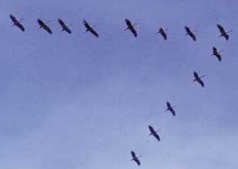

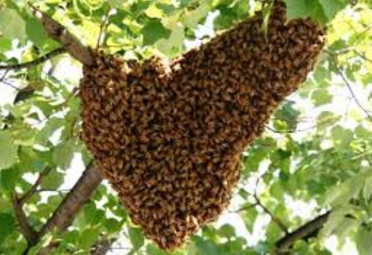
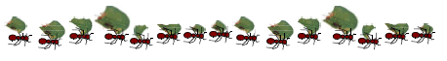
SWARM INTELLIGENCE
Collective behaviour of decentralized, self-organized systems, natural or artificial
Ant Colony Optimization (ACO)
Particle Swarm Optimization (PSO)
Stochastic Diffusion Search (SDS)

Slide 4
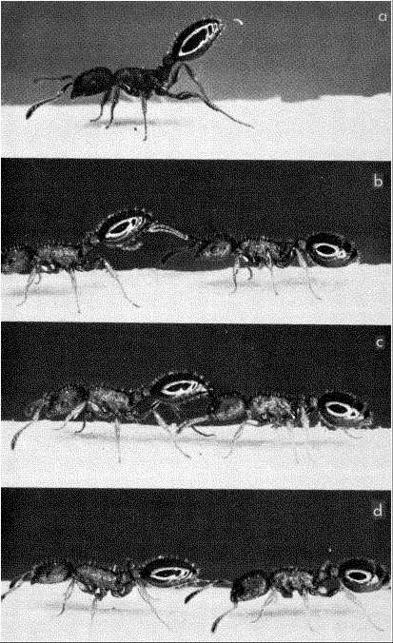
STOCHASTIC DIFFUSION SEARCH [Bishop, 1989]
Robust Swarm Intelligence “Global Metaheuristic”
Population-based
Pattern-Matching algorithm
(One-to-One) communication between the agents
Tandem calling mechanism
Leptothorax acervorum

Slide 5
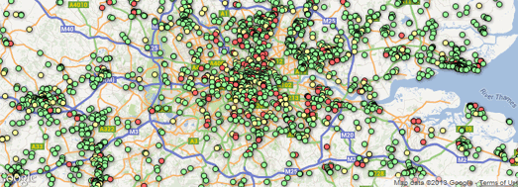
ANALOGY – THE RESTAURANT GAME
Group of delegates arrive in a foreign town and want to find a ‘good’ place to eat
Search Space
Set of All Restaurants
Objective Function
Restaurant quality
Sum of numerous independent partial objective function evaluations

Slide 6
ALGORITHM
Requirement
Objective Function must be decomposable.
Employs swarm of ‘n’ agents
With each agent maintaining a hypothesis
Four Phases
Initialization
Test
Diffusion
Termination
INITIALIZE(agents);
REPEAT
TEST(agents);
DIFFUSE(agents);
UNTIL CONVERGENCE(agents);

Slide 7
INITIALIZATION PHASE
Decide the Number of Agents
Assign each agent a ‘Possible hypothesis’
Assign Stochastically the agents in the Search Space

Slide 8
TEST PHASE
Fitness function used to evaluate hypothesis
Returns ‘TRUE’ if hypothesis is good
Returns ‘FALSE’ otherwise
Each Agent test it’s current hypothesis
If Test Function returned TRUE, the Agent is set as ‘ACTIVE’
Else, the Agent is set as ‘INACTIVE’

Slide 9
DIFFUSION PHASE
Each ‘INACTIVE’ agent, A select another agent B at random.
If B is ‘ACTIVE’
Then the hypothesis of B is copied to A.
Else
Then A selects another hypothesis over the entire search space.

Slide 10
TERMINATION PHASE
Criteria’s for termination
Number of function evaluation
Cluster of agents have the same hypothesis
The function value is in the accepted Threshold
More than 90% of the agents are ‘ACTIVE’

Slide 11
SDS APPLICATIONS
Has been applied to many diverse Search and Optimisation problems
Text search
Lip tracking
Eye tracking
Object recognition
Mobile robot self-localisation
Global Numerical Optimization
Site selection for wireless networks
Sequence detection in bio-informatics

Slide 12
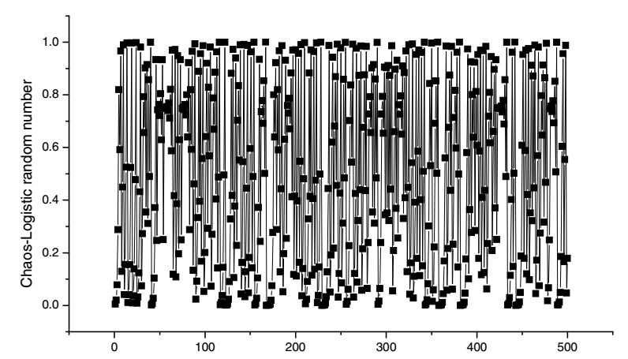
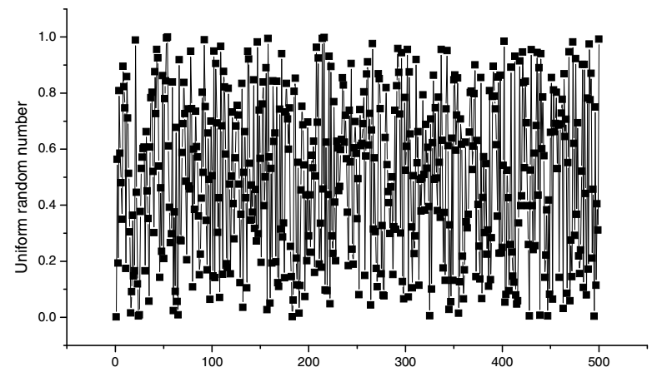
WHY CHAOS ?

Slide 13
PROPERTIES OF CHAOS
Ergodicity
Ensure chaotic variables to traverse all state non-repeatedly within a certain range according to its own laws
Sensitive dependence on Initial Conditions
Ensure that there are not two identical new populations
These populations are deterministic and reproducible
Non-Periodic
Non-Converging
Bounded

Slide 14
“Recently, chaotic sequences have been adopted instead of random sequences and very interesting and somewhat good results have been shown in many applications”
Secure Transmission (Suneel, 2006; Wong, Man, Li, & Liao, 2005)
Nonlinear Circuits (Arena, Caponetto, Fortuna, Rizzo, & La Rosa, 2000)
DNA Computing (Manganaro & de Gyvez, 1997)
Image Processing (Han, Hu, Yu, & Wang, 2007)

Slide 15
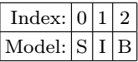
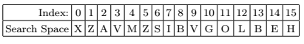
TEXT SEARCH
To find a set of letters within a larger string of letters.
Example
To find a 3-letter model in a 16-letter search space
4 Agents
Model
Search Space

Slide 16
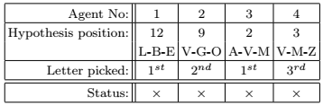
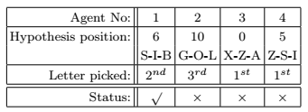
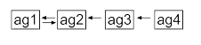
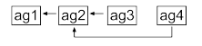
Iteration 1
Iteration 2

Slide 17
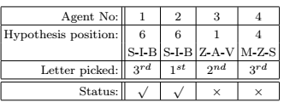
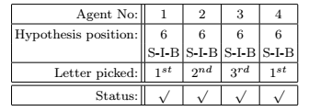
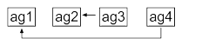
Iteration 3
Iteration 4

Slide 18
EXPERIMENT & RESULT
Experiment Setup
Search String length – 5
Actual String length – 445
Number of Agents – 5
Result
Time taken to find the Search String averaged over 100 iterations
Random Assignment of Agents - 0.017666 sec
Chaotic Assignment of Agents - 0.016558 sec

Slide 19
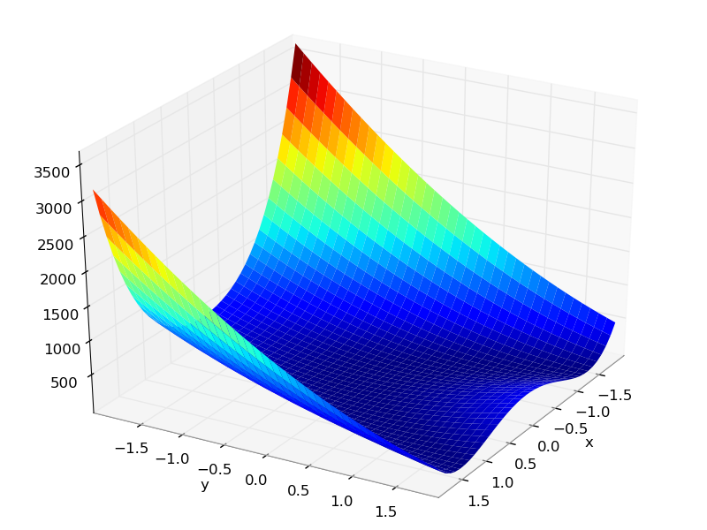
GLOBAL NUMERICAL OPTIMISATION
Issues in Global Optimization problems
Algorithms may tend to get stuck in the local optima
Convergence-rate is usually very low when there are numerous local optima

Slide 20
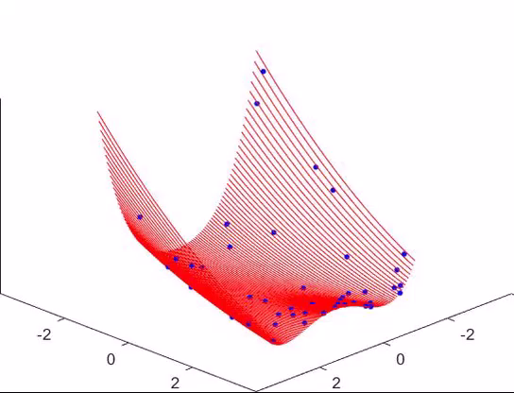

EXPERIMENT & RESULT
Experiment Setup
Rosen Brock Function
Number of Agents – 100
Results
The Function Min Value
Chaotically – 0.029
Randomly – 0.035

Slide 21
BONE METASTASIS
Occurs when cancer cells from the primary tumour, such as prostate, breast, and lung cancer, spread to the bone.
Typically 2-6 hours after intravenous administration of technetium-99m-Iabeled diphosphonates
Brighter areas in the bone scan indicate Metastasis

Slide 22
EXPERIMENT
Experiment Setup
Number of Agents – 10,000
Number of Iterations – 10
Agents are initialized Chaotically
If average intensity of the agent and neighbors is greater than 180
Agent becomes ‘ACTIVE’
Else
Agent becomes ‘INACTIVE’

Slide 23
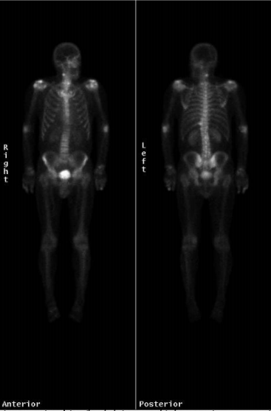

HEALTHY BONE SCAN

Slide 24
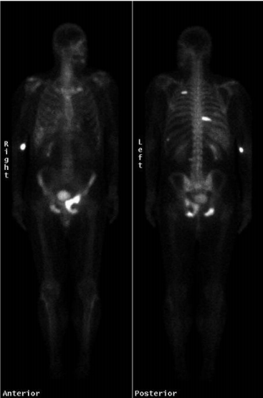

PARTIALLY AFFECTED BONE SCAN

Slide 25
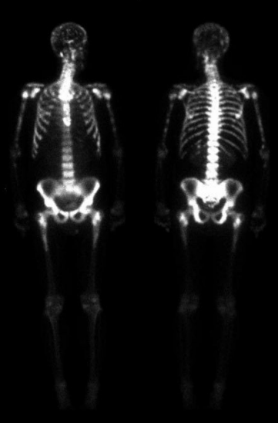

METASTASIS DISEASE SPREAD BONE SCAN

Slide 26
RESULT
Chaotic
Random
Number of Active Agents
Number of Active Agents

Slide 27


Slide 28
Thank You!

